Slide 1
How To: React to Spam
By John

Slide 2

"Hello John your my only hope:
I have an interesting business proposal I want to share with you,
- Simba Mandela HQ in Nigeria.

Slide 3

“Simba, your Situation worried me. So iam ready to join.”

Slide 4
“Dear John, We shall be shipping Gold to you. 25 KGs”

Slide 5
“Simba, if we're going to do it, let's go big.
here's no point doing this at all
unless you're shipping at least a ton”

Slide 6
“So what are you doing for a living?”

Slide 7
“I'm a hedge fund CEO bank manager."

Slide 8
"It will not be easy to convince my company
to do larger quantity shipment."

Slide 9
"Simba, I'm completely with you on this one.
I'm putting together a visual
for you. Be patient!”

Slide 10
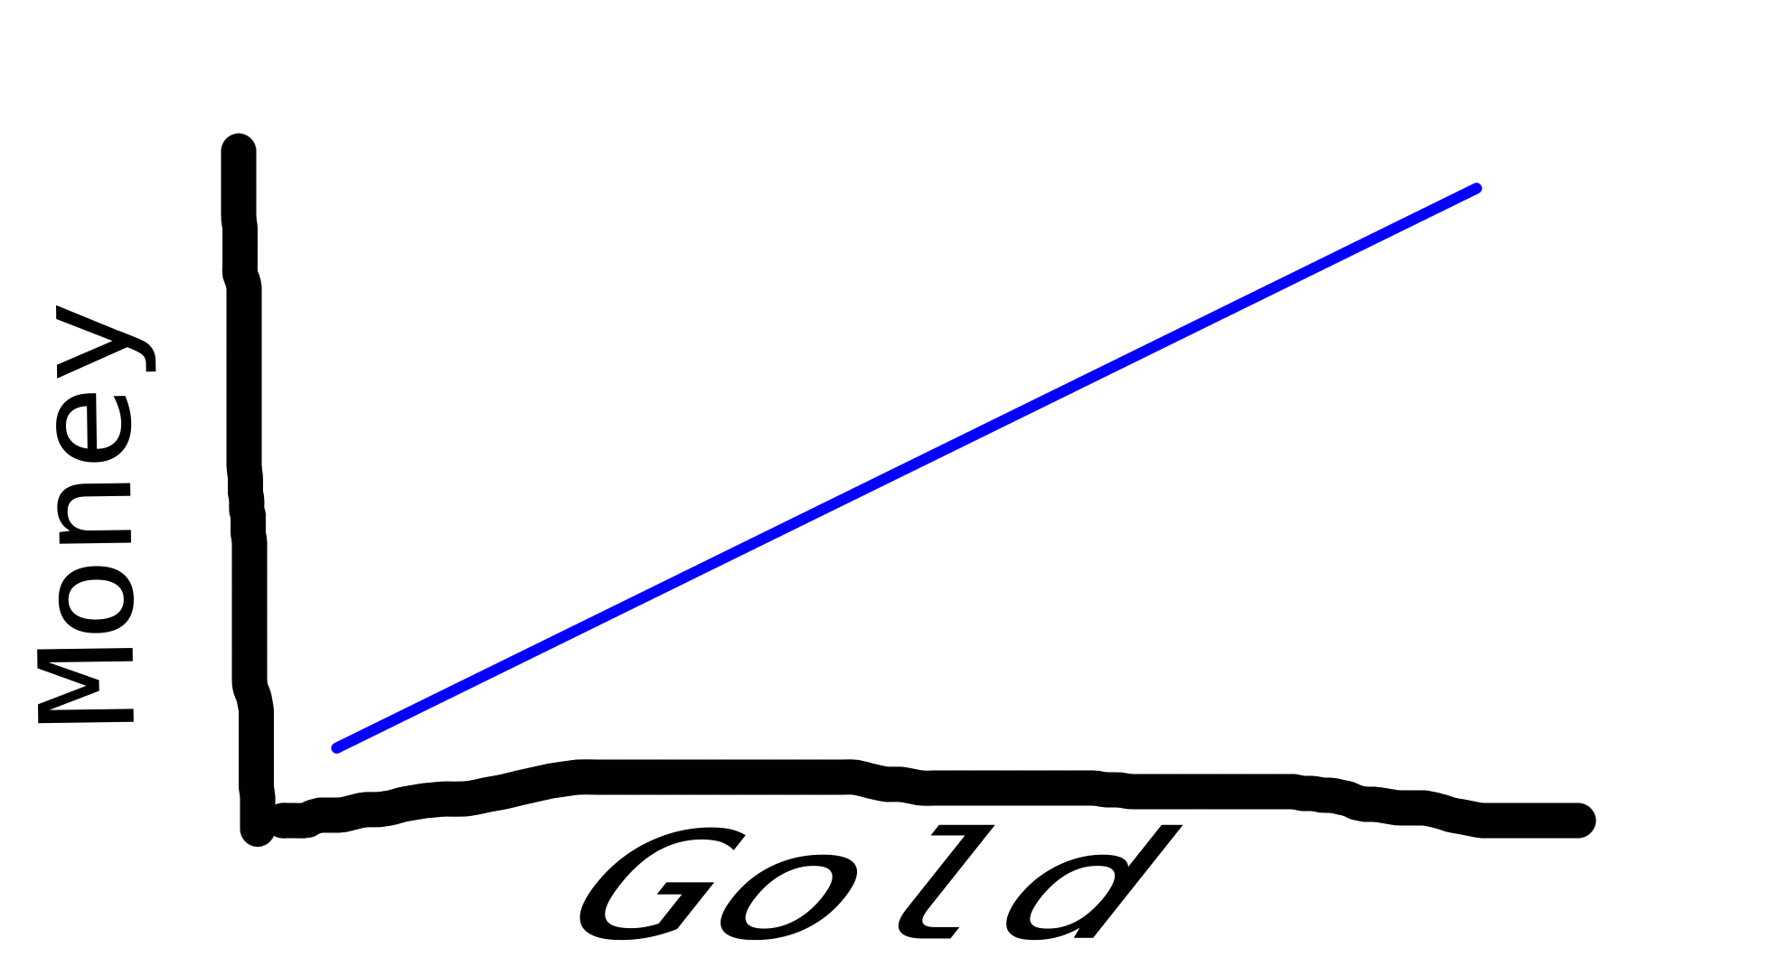

Slide 11
"Simba, attached to this email youll find a helpful graph.
Ive had one of my assistants calc the numbers.
Iam ready many as you wish!”

Slide 12
Would you give me your Mobile Number so I can call
You.

Slide 13
+44 20 7066 1000

Slide 14
John this is the Number of American Express.
And they sad to me I should be carefull about you...

Slide 15
“John I think youre not serious…
Thats not funny you know my
Brother health condition is bad...”

Slide 16
“No I didn’t know. Who is your brother”

Slide 17
“Nelson Mandela”

Slide 18
“OH NO sry! I heard about Nelson health condition.
Considering he is dead for 3 Months I would consider
His Health condition as VERY SERIOUS.

Slide 19
“I have to go to bed now”

Slide 20
“Have sweet Dreams”

